Slide 1

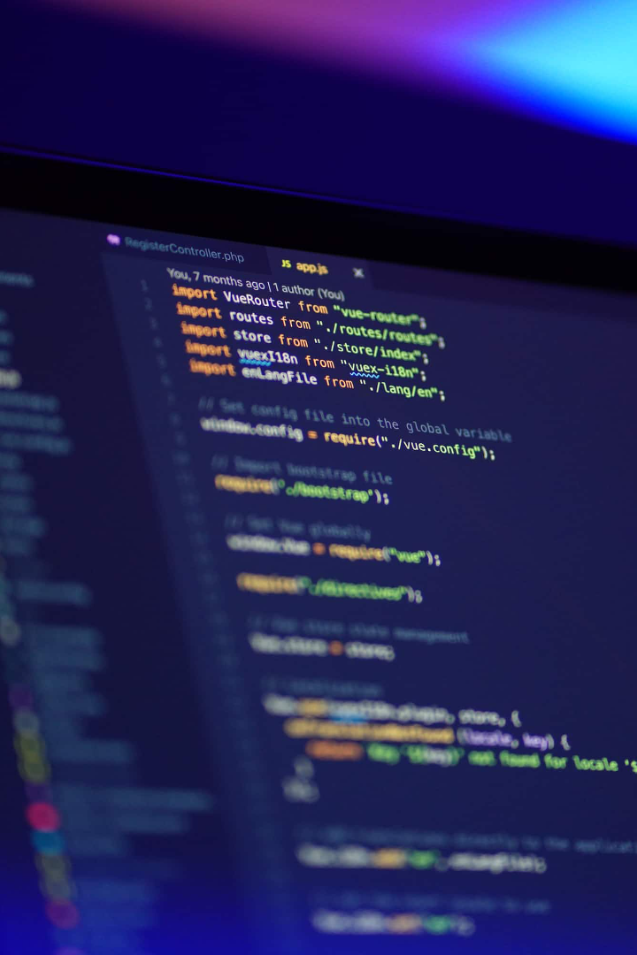
SURYA GROUP OF INSTITUTIONS
RAM KUMAR M
422221104303
eBPL (Artificial Intelligence)
TEAM-11

Slide 2

Building a Smarter AI-Powered Spam Classifier using Python Programming
In this guide, we will explore the process of building a highly intelligent spam classifier using the power of Python programming. By utilizing state-of-the-art machine learning algorithms and advanced natural language processing techniques, we can create an efficient system that effectively identifies and filters out spam messages. Through this comprehensive tutorial, we will cover the key steps involved in developing this intelligent spam classifier, from data preprocessing and feature engineering to model training and performance evaluation. Let's dive in and discover how we can create a more secure and spam-free digital environment!

Slide 3
The Importance of Spam Classification
Protect Your Inbox
Enhanced Security
Improved Productivity
Spam emails can clutter your inbox, making it difficult to find important messages. By implementing an intelligent spam classifier, you can ensure that your inbox remains clean and organized, saving you time and frustration.
Spam emails often carry malicious content, such as phishing scams and malware. By accurately identifying and filtering out spam, you can significantly reduce the risk of falling victim to such security threats.
By eliminating the distraction caused by unwanted spam messages, you can focus better on your tasks, improving productivity and efficiency in both personal and professional settings.

Slide 4
The Data Preprocessing Stage
1
Data Collection
2
Cleaning and Tokenization
3
Stop Word Removal
Collect a diverse dataset of spam and non-spam emails containing a wide range of characteristics and patterns for training the classifier effectively.
Remove any irrelevant information and perform tokenization to break down text into individual words or tokens, facilitating the subsequent feature extraction process.
Eliminate common words, known as stop words, from the text as they provide little or no useful information in differentiating spam from non-spam messages.

Slide 5

Feature Engineering for Intelligent Classification
Feature engineering plays a crucial role in building an effective spam classifier. By carefully selecting and transforming informative data attributes, we can enable the classifier to capture the distinguishing characteristics of spam messages. Various techniques such as word frequency analysis, TF-IDF (Term Frequency-Inverse Document Frequency), and email metadata extraction can be applied to extract meaningful features for classification.

Slide 6
Choosing the Right Machine Learning Algorithm
Naive Bayes
Support Vector Machines (SVM)
Random Forest
Naive Bayes classifiers are commonly used for spam classification due to their simplicity and efficiency. They assume that the features are conditionally independent, making them suitable for text classification tasks.
Random Forest models leverage the power of ensemble learning by combining multiple decision trees. They are robust against overfitting and can provide accurate spam classification results.
SVM algorithms can effectively handle complex decision boundaries and work well in high-dimensional spaces. They have proven to be successful in spam classification tasks by constructing optimal separating hyperplanes.

Slide 7
Evaluating Classifier Performance
Precision
Precision measures the accuracy of classifying spam messages. It represents the ratio of correctly classified spam messages to the total number of messages classified as spam.
Recall
Recall, also known as sensitivity or true positive rate, measures the ability of the classifier to identify all spam messages correctly. It represents the ratio of correctly classified spam messages to the total number of actual spam messages.
F1 Score
The F1 score is the harmonic mean of precision and recall. It provides a comprehensive evaluation metric that balances between precision and recall, taking into account both false positives and false negatives.

Slide 8
Taking Model Deployment to the Next Level
Once our spam classifier is trained and evaluated, we can deploy it to various platforms for real-time spam detection. Integration with email servers, web applications, and mobile devices can ensure continuous protection against spam messages across multiple communication channels.

Slide 9

Continual Improvement and Adaptation
1
Monitoring and Feedback Loop
Regularly monitor the performance of the spam classifier and collect user feedback to identify areas for improvement. This feedback loop enables the system to continuously learn and adapt to the evolving nature of spam messages.
2
Implementing Advanced Techniques
Explore advanced techniques such as deep learning and ensemble methods to further enhance the spam classification accuracy and robustness.
3
Collaboration and Knowledge Sharing
Engage with the data science community to tap into collective expertise and collaborate on research and development projects related to spam classification. Sharing knowledge and insights can lead to breakthrough advancements in the field.

